Slide 1

Data Exploration on Caravan Insurance

Slide 2

Needle in a Haystack
Purpose of this project
Seeking potential buyers of Caravan Insurance
Who and why they may be at least interested

Slide 3

Data
Source: https://www.kaggle.com/uciml/caravan-insurance-challenge
Variables
85 Variable
Categorical Variables problem

Slide 4
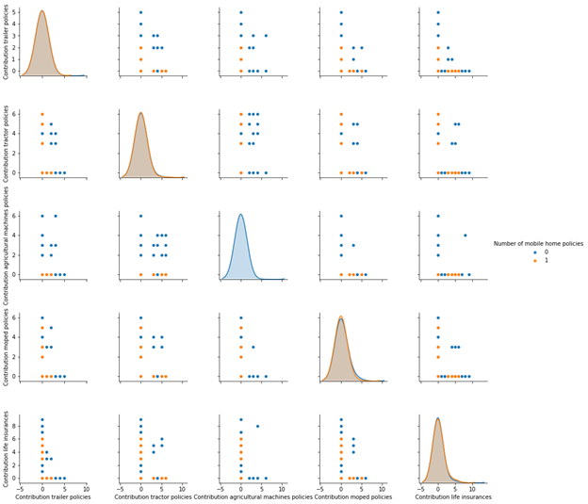
EDA
Pair Plot
The pair plot shows how 1 variable may or may not correlate with the other
When a variable paired with itself, the histogram is produced instead
The plot is showing groupings with observations with target variable = 0, in blue, or target variable = 1, in orange

Slide 5
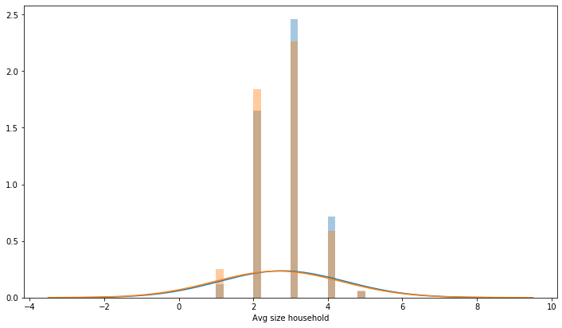
EDA
Histogram
Exploring data with histograms
Look closer by variable
Trying to see if visually there’s a noticeable difference those who have Caravan Insurance to those who don’t

Slide 6
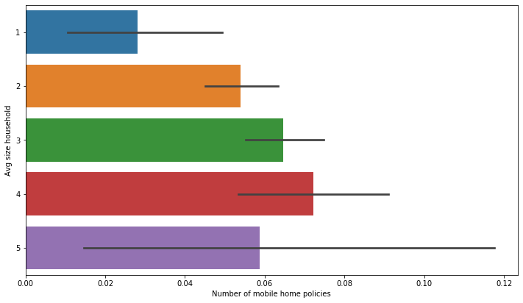
EDA
Bar Plot
Another perspective to explore data
Looking at the mean proportion to see if there’s a difference by class within a given variable

Slide 7
Statistical Inference
Chi Square test
Infer whether a variable has its mean estimate different from the overall mean
Bootstrap
Simulate the data and graphically represent

Slide 8
Analysis with Machine Learning Models
Data for modeling
Reducing dimension from 85 variable to 23 variable
Based on the P-value on each variable in the Chi-Square test
Classification Problem
Yes/No vs. Continuous

Slide 9
Models for consideration
Decision Tree
Basic Model for Reference
Random Forest
Expansion of Decision Tree
Gradient Boost Machine
Logistic Regression

Slide 10
Understanding model performance
Confusion Matrix, Precision, Recall and Accuracy
ROC and AUC
Lift charts and Cumulative Gain Chart

Slide 11
Performance Measure from Confusion Matrix
Comparison on Test Data | Classification Tree | Random Forest | GBM | Logistic Regression
Accuracy | 0.891 | 0.934 | 0.94 | 0.94
Precision | 0.114 | 0.25 | 0.429 | 0.5
Recall | 0.122 | 0.055 | 0.013 | 0.013

Slide 12
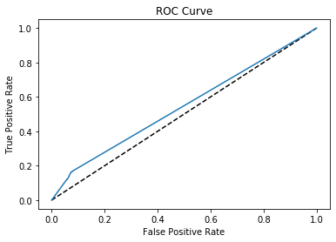
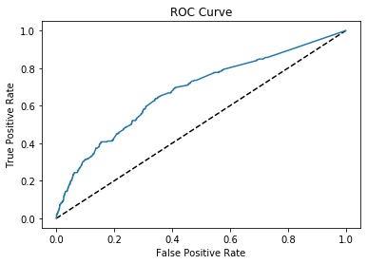
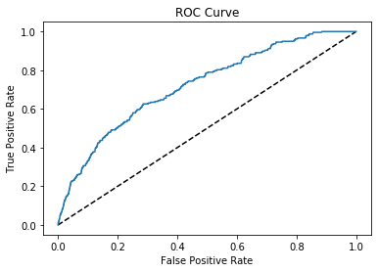
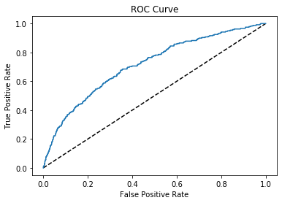
ROC and AUC
Decision Tree
Random Forest
GBM
Logistic Regression

Slide 13
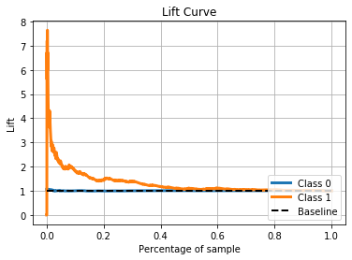
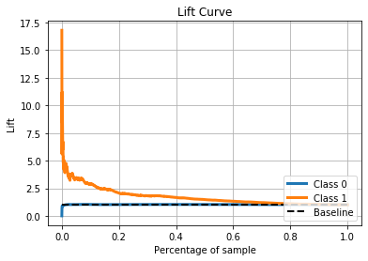
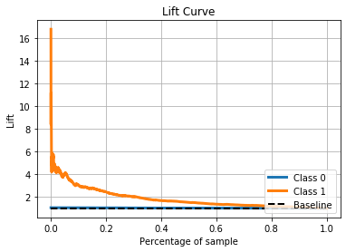

Lift Charts
Decision Tree
Random Forest
GBM
Logistic Regression

Slide 14
Future Considerations
Addressing Imbalance of Data
Experiment with other models

